Slide 1
Human Resource Department
CMSC 127

Slide 2
Discussion Outline
Data Dictionary
SQL Schema
UI Prototype 1

Slide 3
Data Dictionary

Slide 4
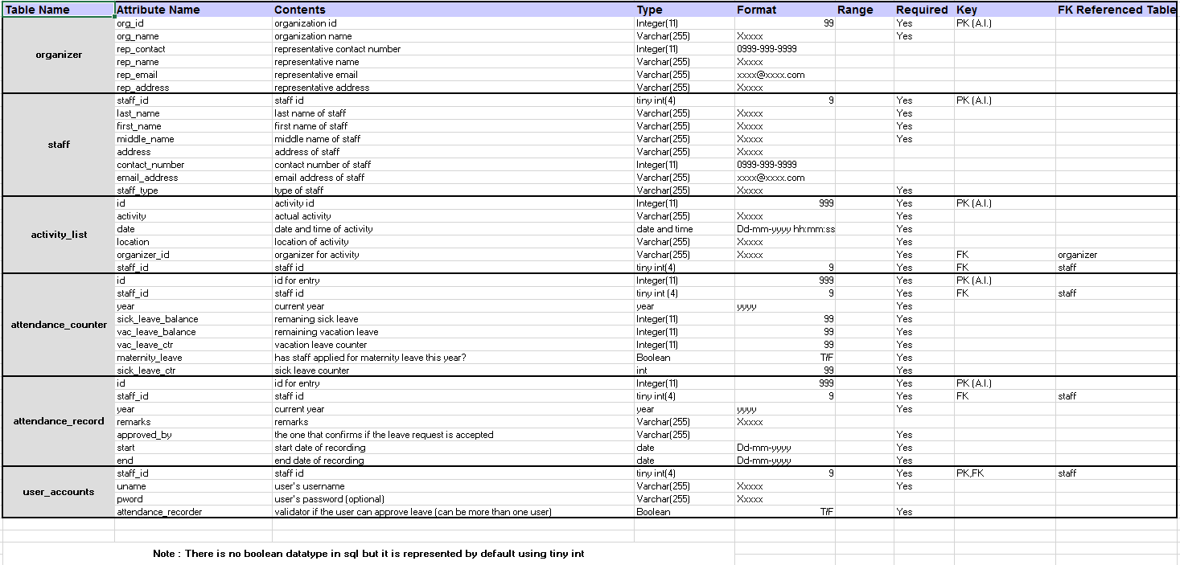
Data Dictionary

Slide 5
SQL Schema

Slide 6
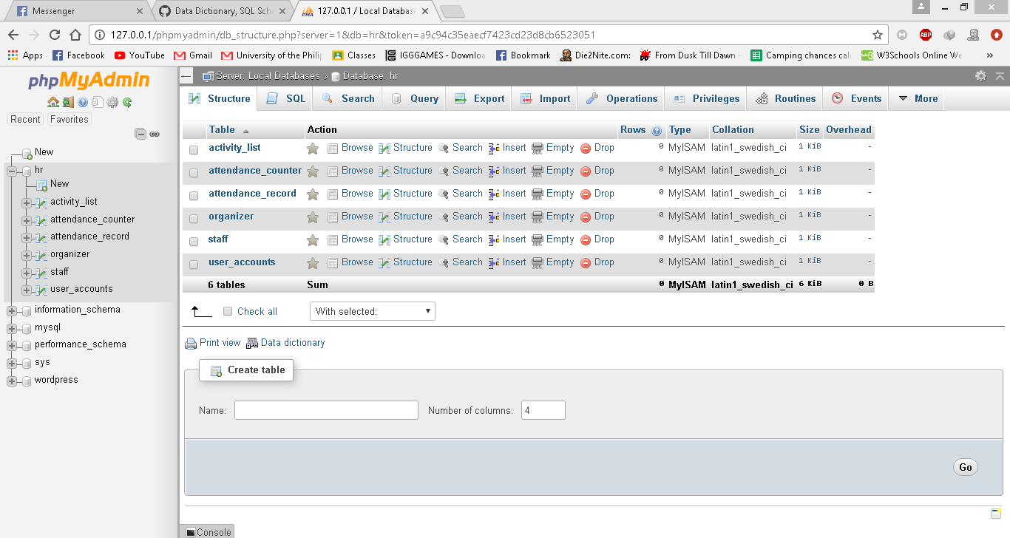
Tables

Slide 7
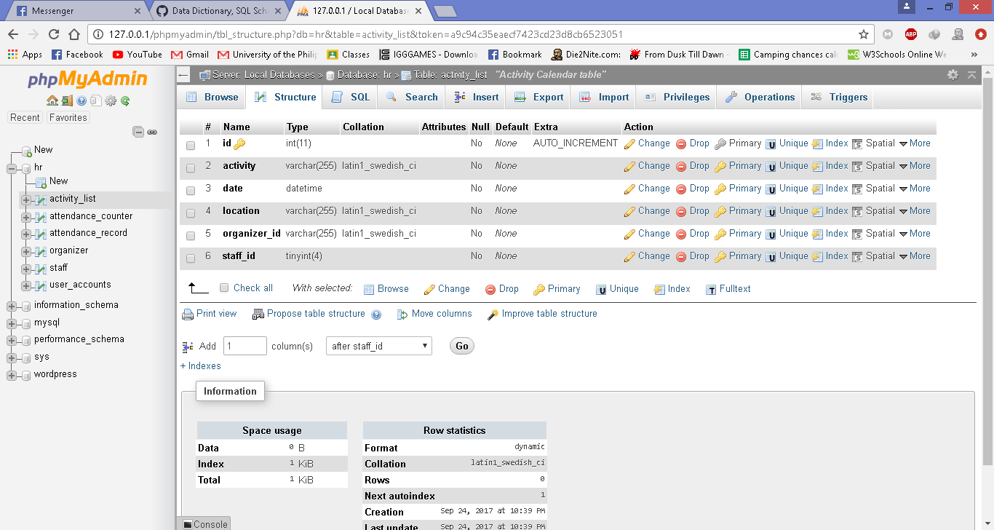
activity_list

Slide 8
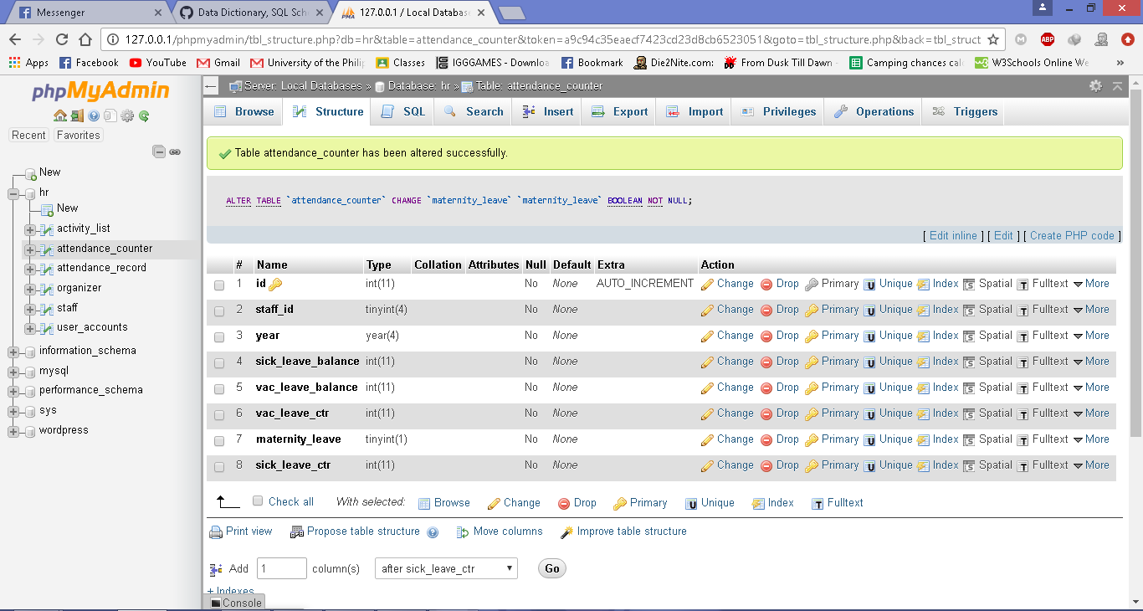
attendance_counter

Slide 9
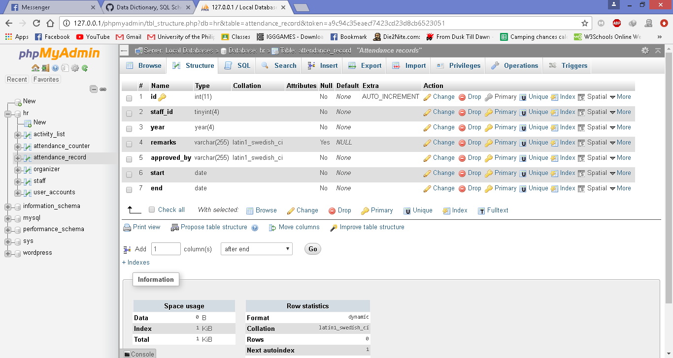
attendance_record

Slide 10
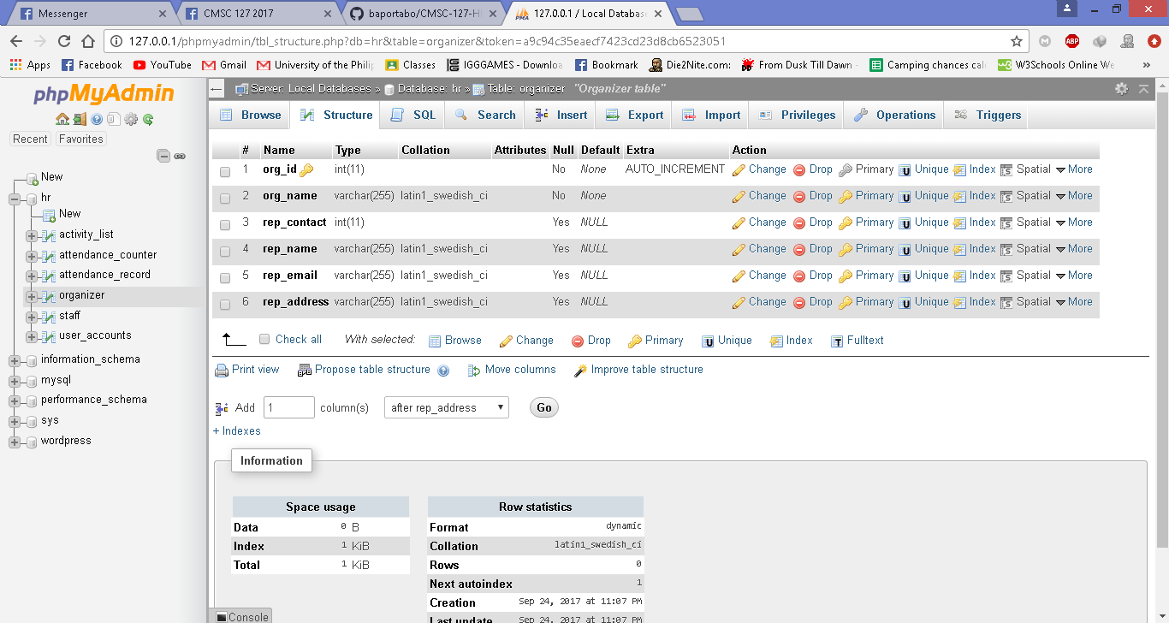
organizer

Slide 11
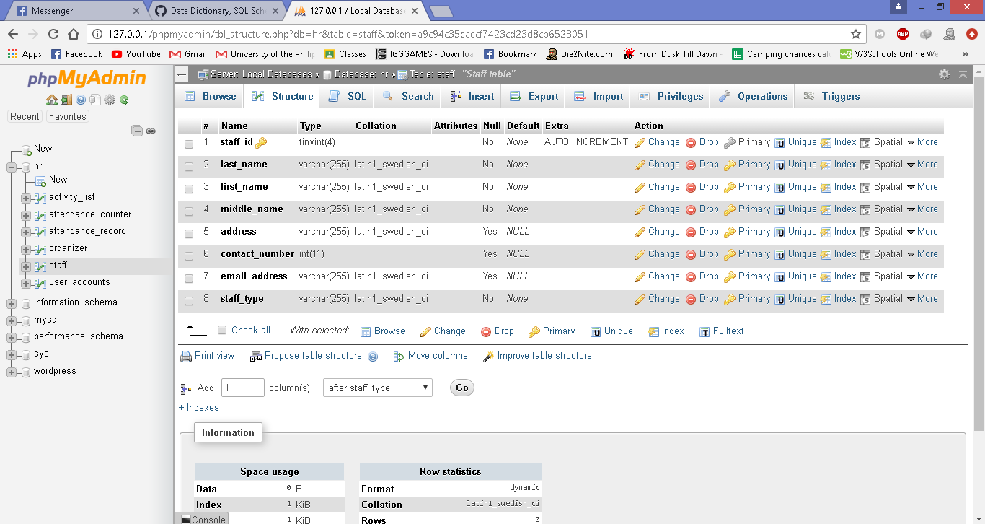
staff

Slide 12
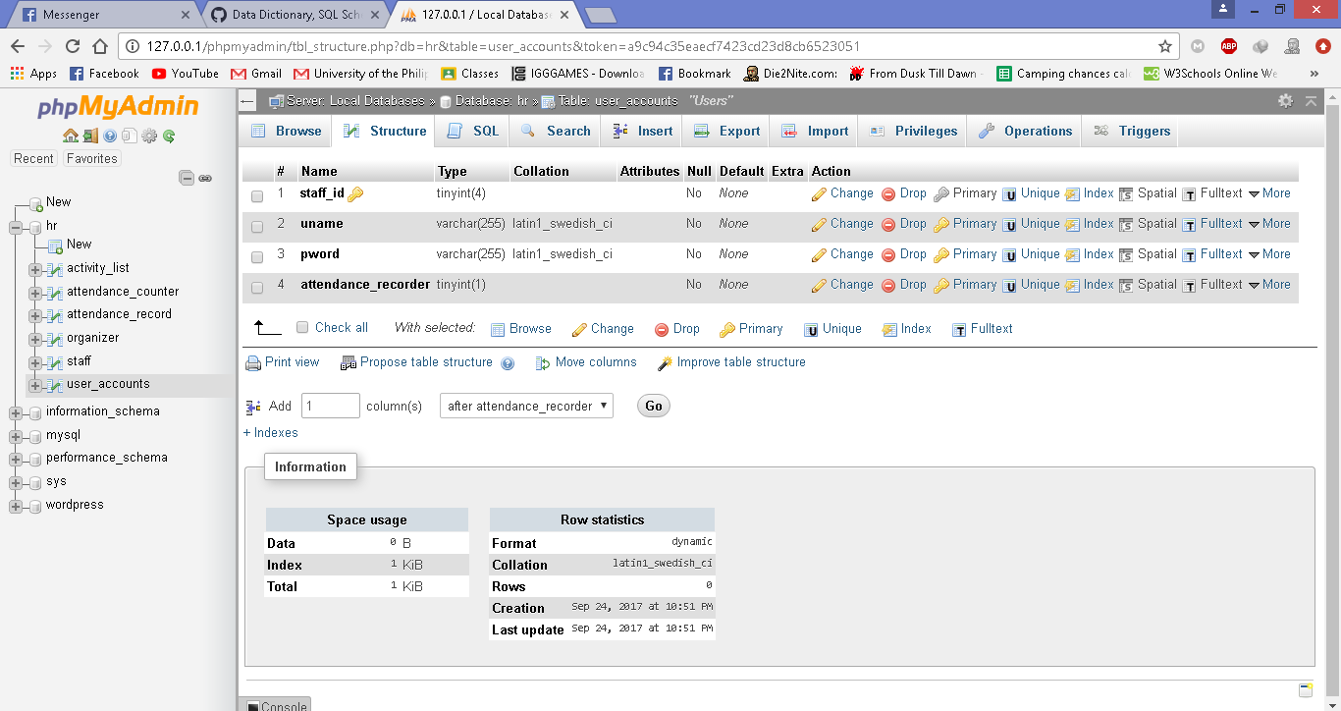
user_accounts

Slide 13
UI Prototype 1

Slide 14
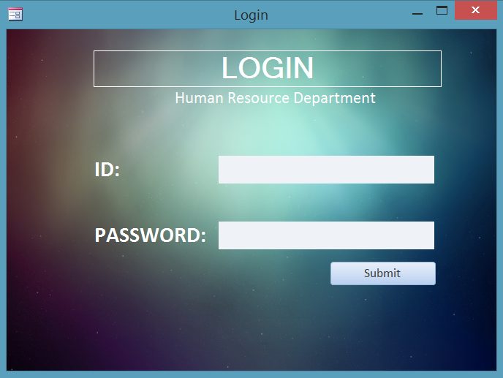
Login

Slide 15
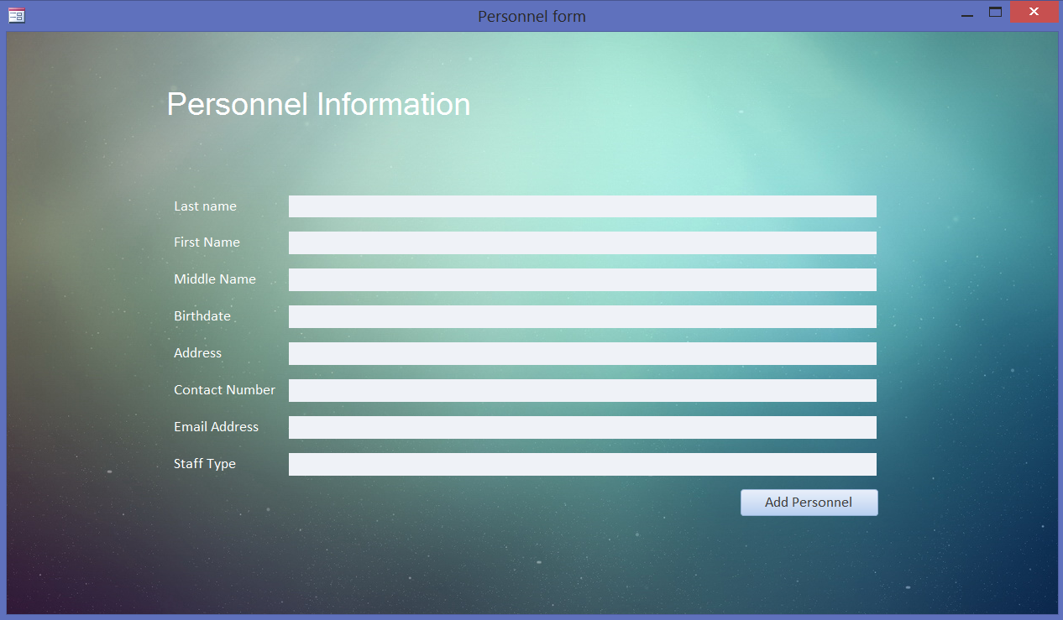
Add Personnel

Slide 16
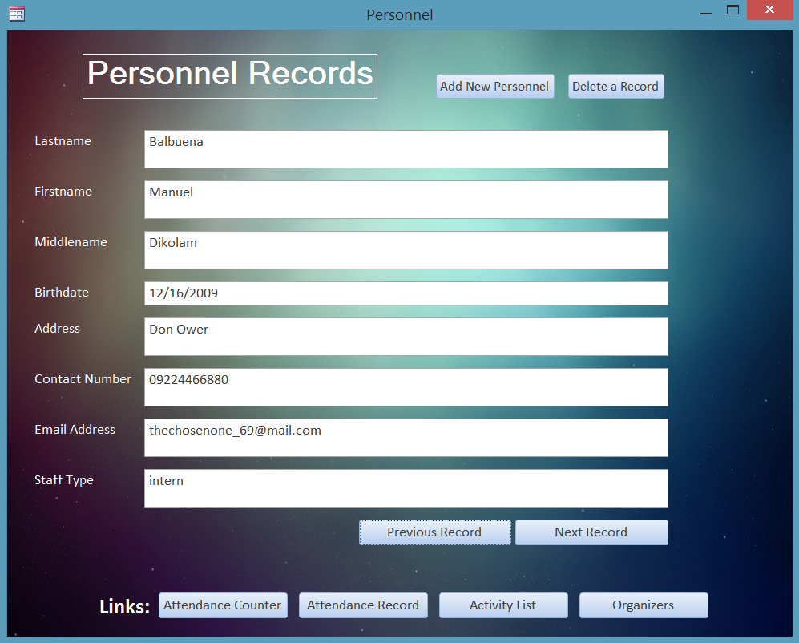
Personnel Records

Slide 17
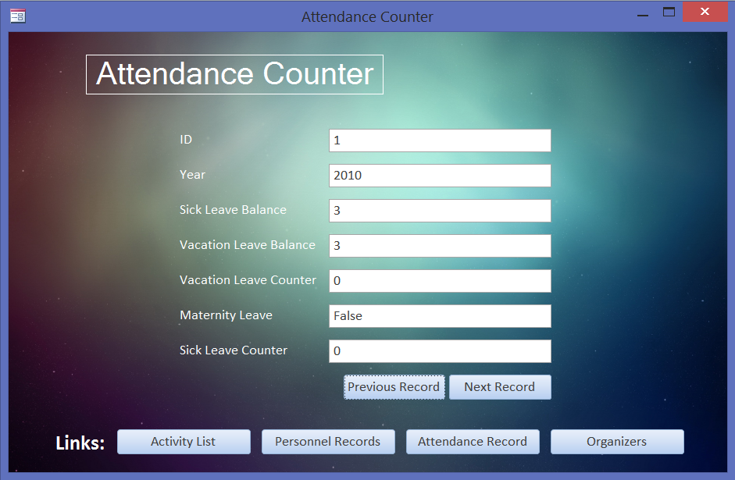
Attendance Counter

Slide 18
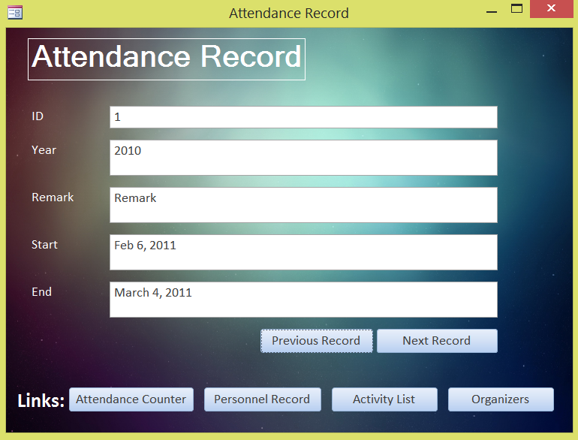
Attendance Record

Slide 19
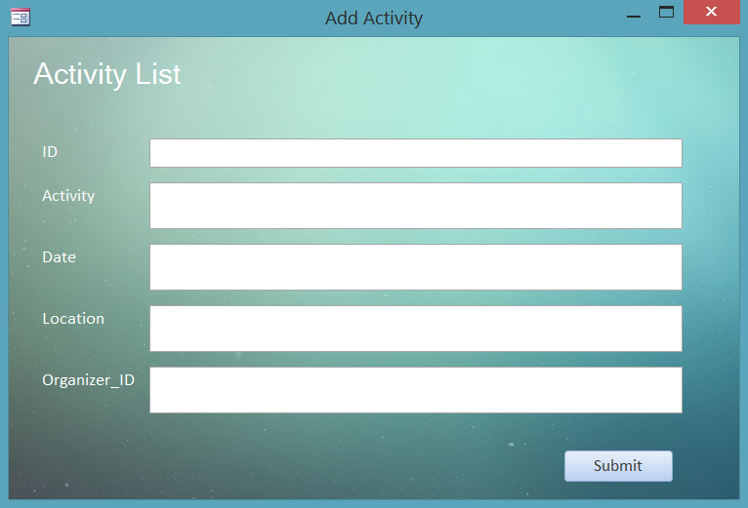
Add Activity

Slide 20
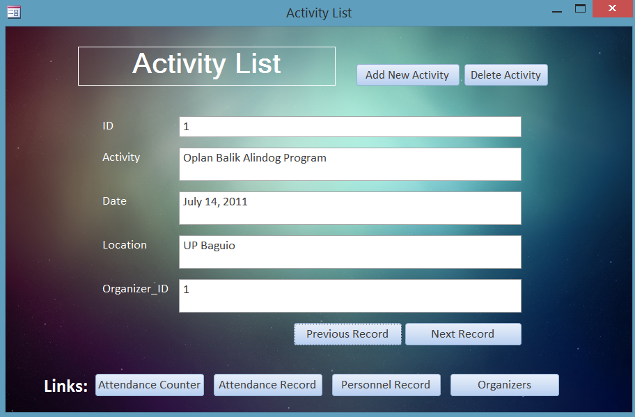
Activity List

Slide 21
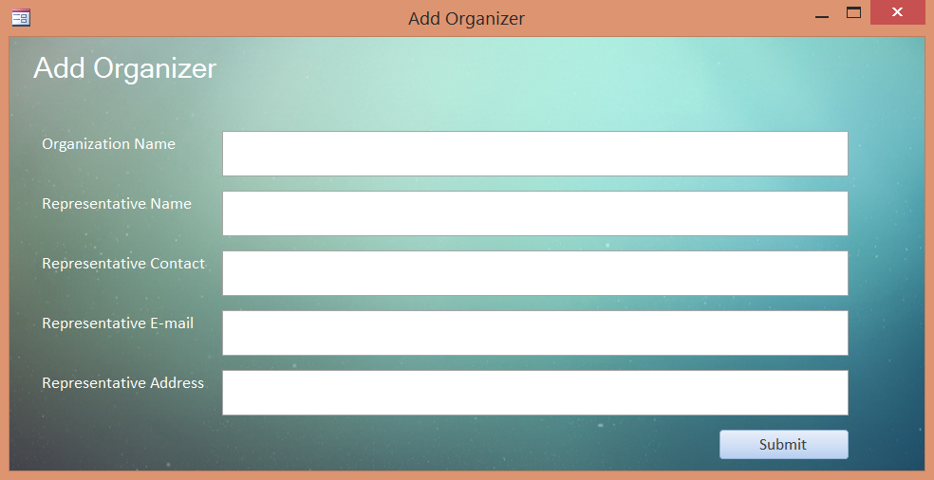
Add Organizer

Slide 22
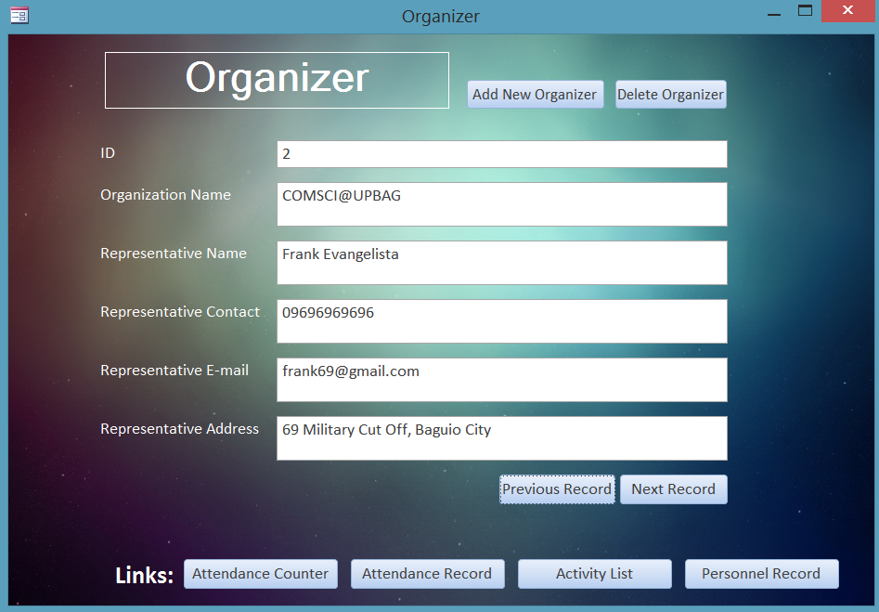
Organizer

